Slide 1
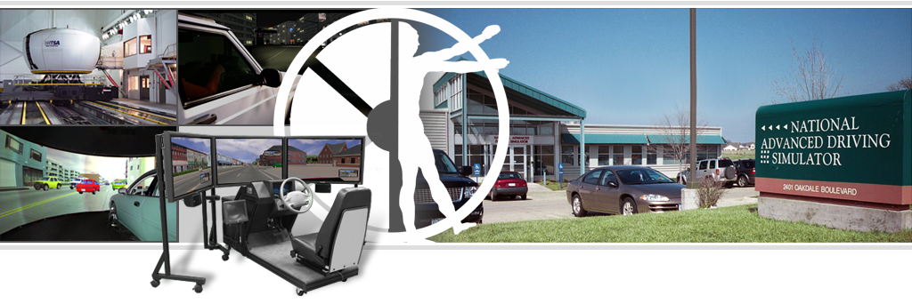
Overview of Selected
MiniSim™ Projects
National Advanced Driving Simulator (NADS)
The University of Iowa

Slide 2
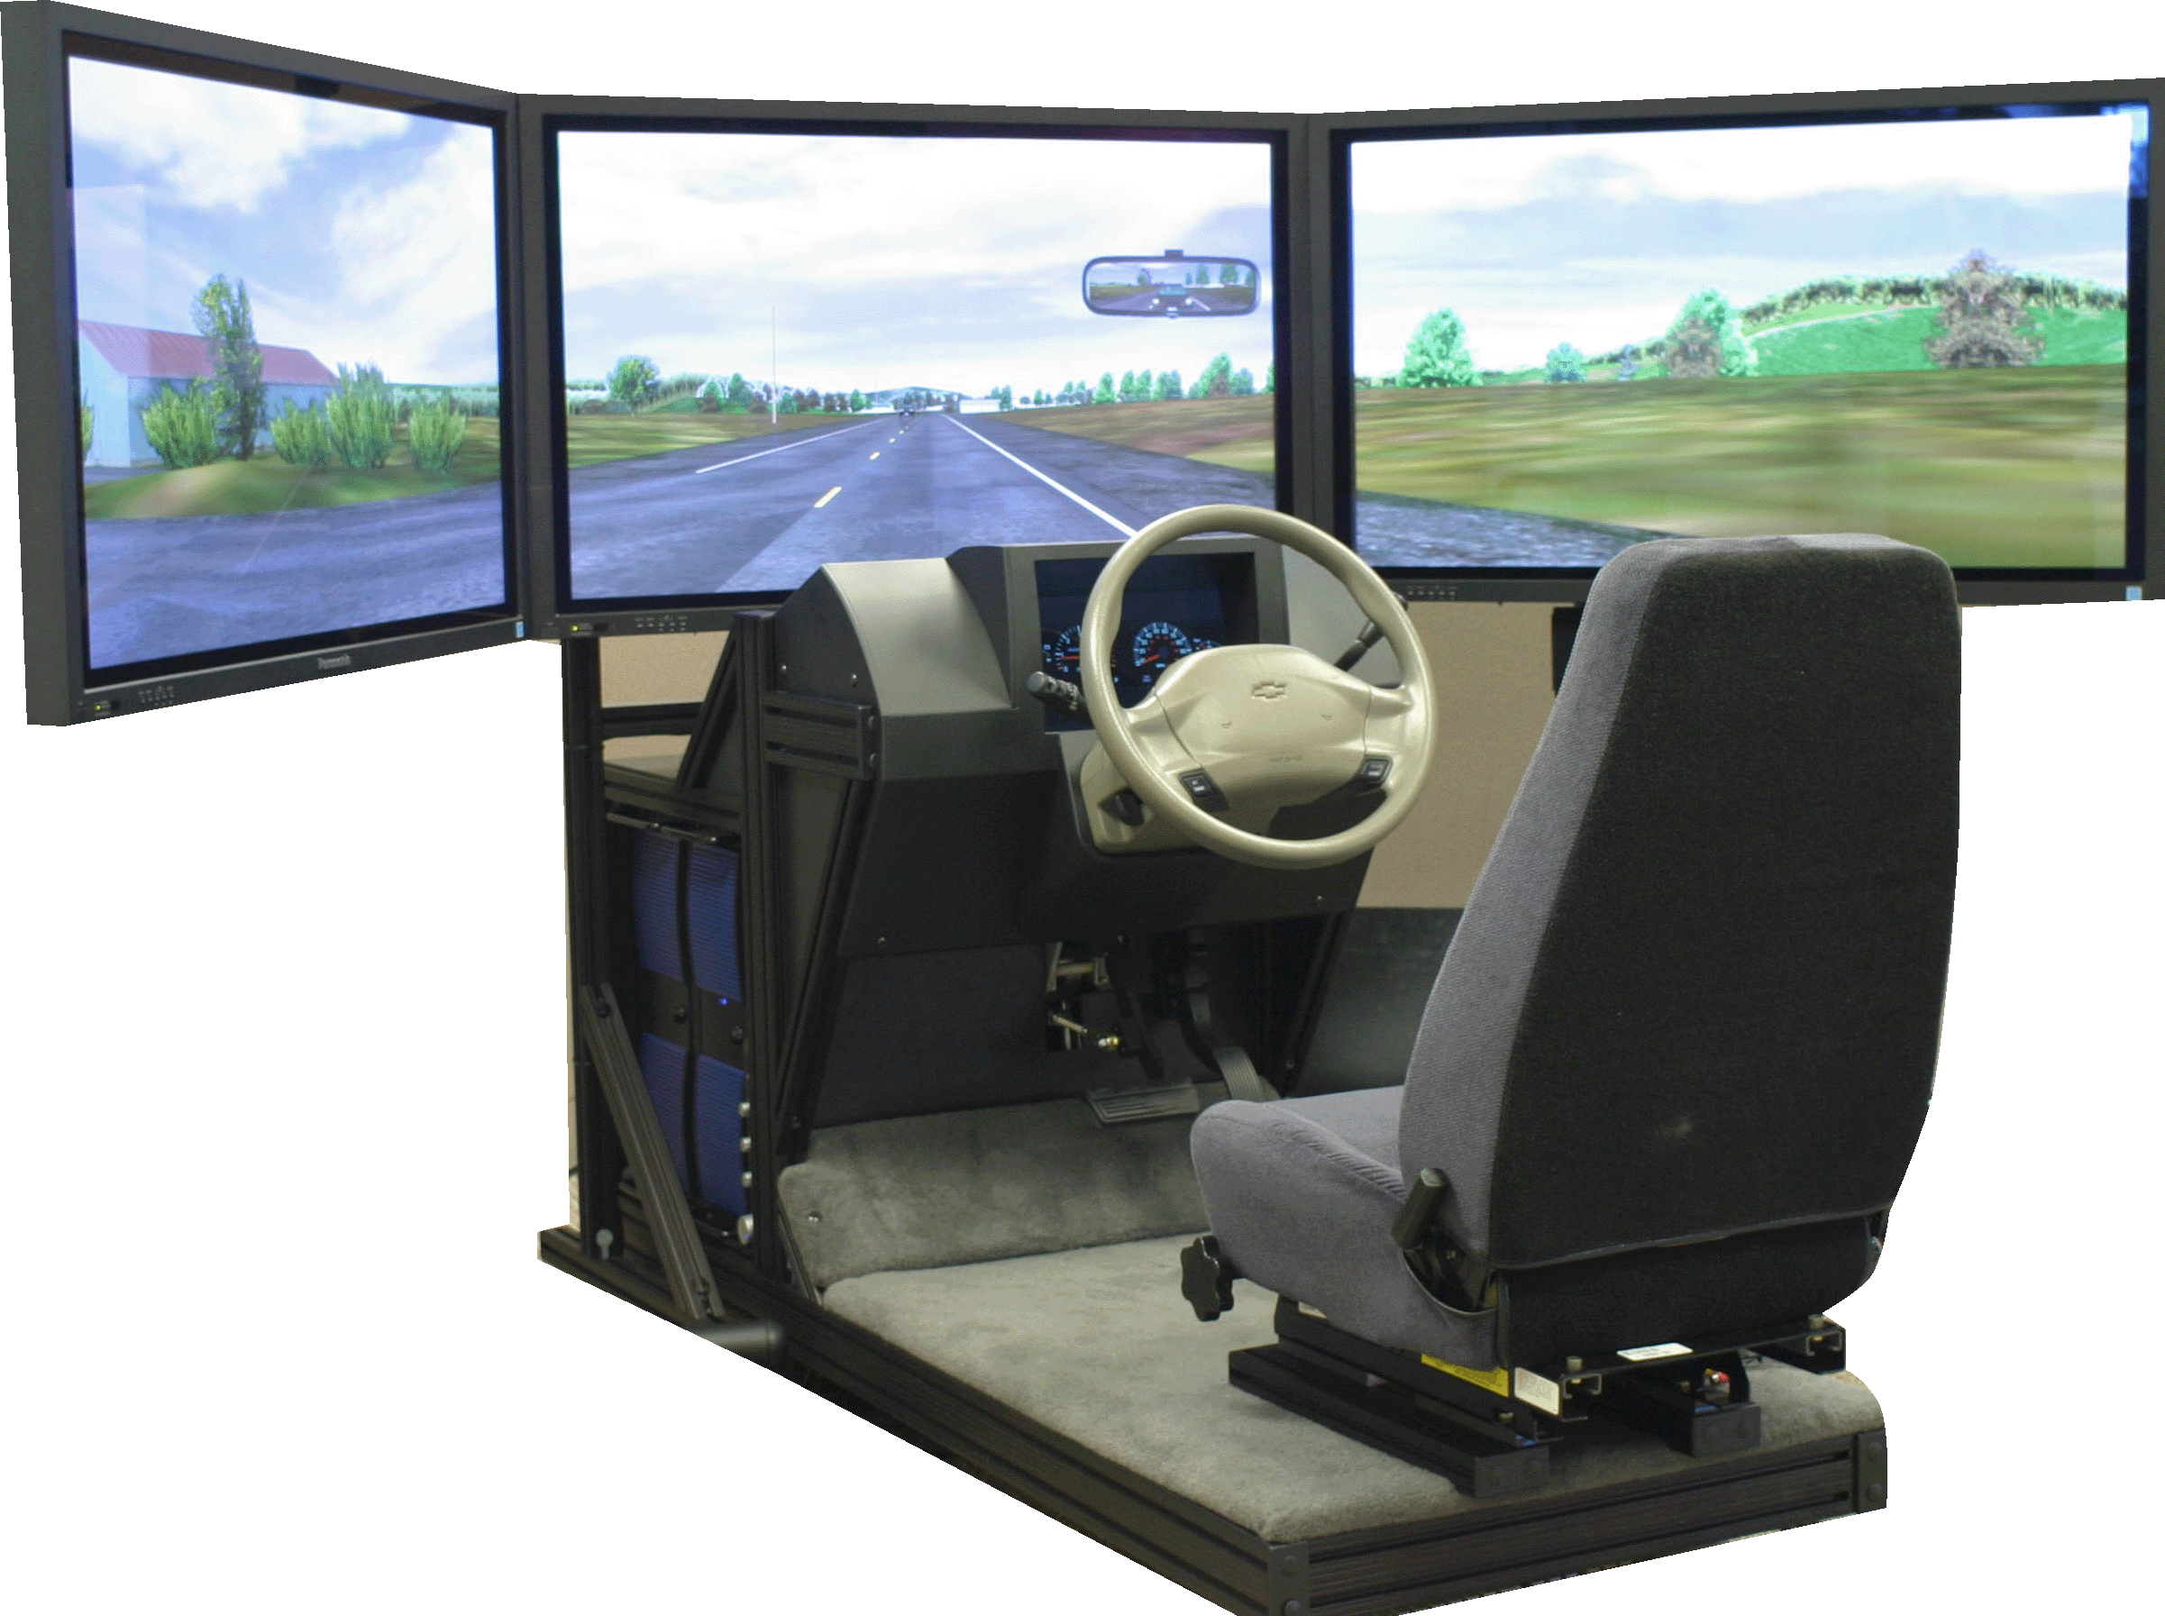
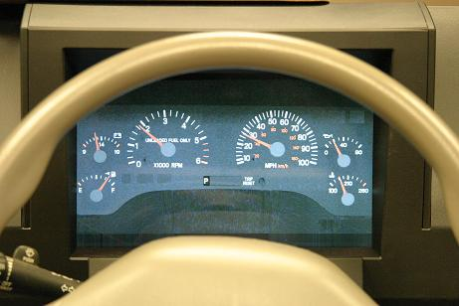
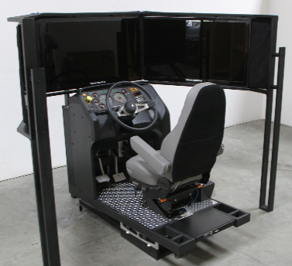
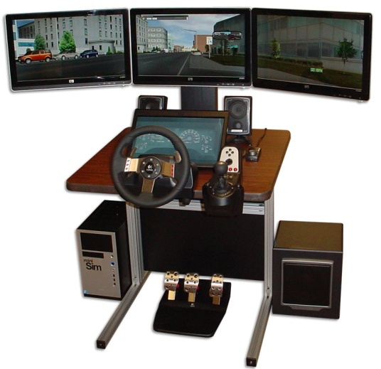
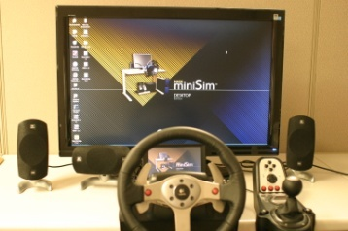
NADS MiniSim™
Portable, small footprint
Off-the shelf parts, easy to service
Reliable
Cost effective
Multiple configurations
Web-site provides connection to national network of researchers and practitioners

Slide 3
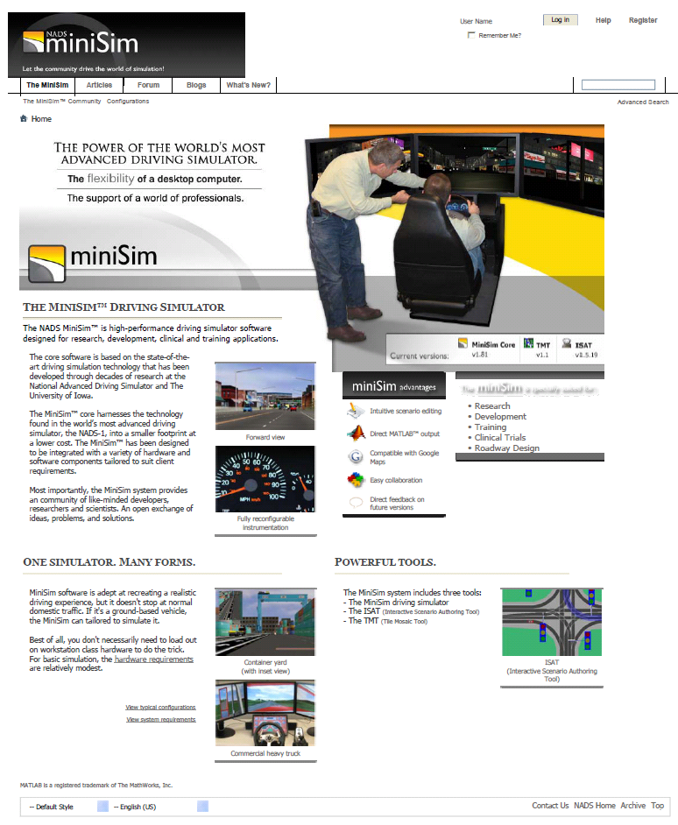
MiniSim™ Web
Accessible by MiniSim users and driving sim researchers around the country
User forums enable sharing of ideas, research
Knowledge base
Software updates
Student involvement
Blogs
MiniSim configurations for purchase
Articles on state of the art in field
Links to research

Slide 4
NADS MiniSim™ Partners
(Green=Vehicles, Blue=Heavy Trucks, Red=Both)
Hartford Hospital
United Tribes Technical College, ND
U. of Wisc-Madison
Michigan Tech.
U. of Washington
Iowa DOT/ ISU
CSU San Bernardino
UI Colleges of Engineering and Medicine
NHTSA,
US DOT
Florida State University
U. of Texas-Austin
Cognitive Research Corporation

Slide 5
MiniSim Partnerships
Application
Partners / Source of Funding
Highway Design
Transportation Regulatory Agencies
Driver’s Education
Automotive Industry
Safety/Remedial Training
Pharmaceutical Industry
Clinical Trials
Universities
Vehicle Safety & New Technologies
NIH/NSF
Clinical Assessment
Defense Industry / DOD
Military Training and Simulation

Slide 6
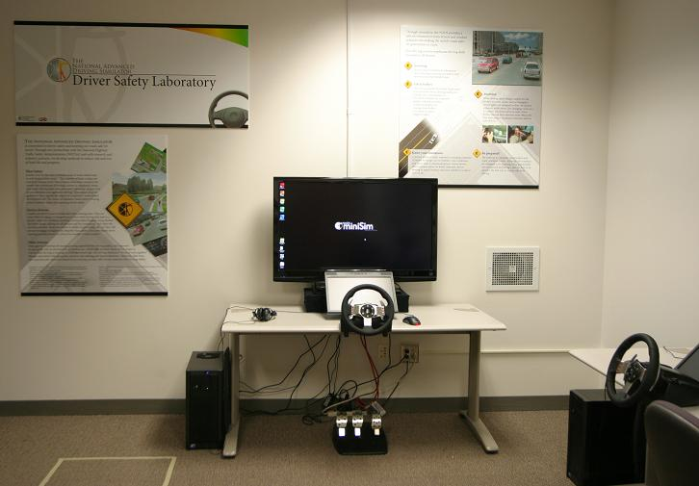

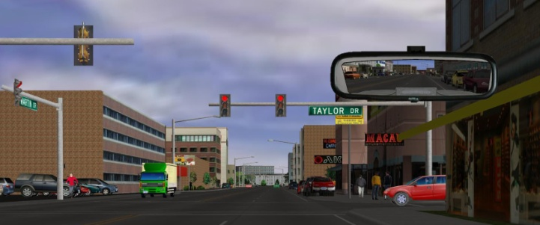
NADS Driver Safety Training Program
Provide driver safety training for company fleets
  Improve driving practices
2-hour training program consisting of training scenarios, safety presentations
Developed in consultation with local company and safety committee
Three dedicated simulators
Cost $125/trainee

Slide 7

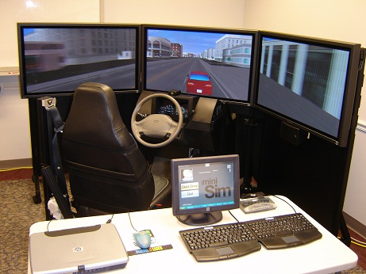
Collision Warning Interface Demonstrator
Focus Area: Active Safety
Simulated user interface options to 4 active safety technologies
  Forward collision warning (FCW)
  Blind spot warning
  Backup collision warning
  Lane departure warning (LDW)
Developed software models of collision warning systems and integrated hardware haptic seat, steering and active seat belt
Developed 2 scenarios that present a driving experience for a focus group clinic for 200 participants at manufacturer’s site on portable MiniSim™ driving simulator

Slide 8

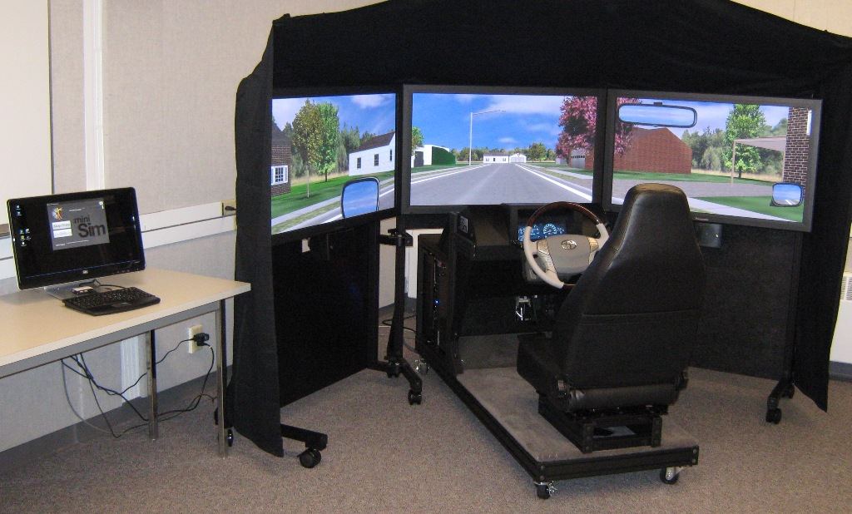
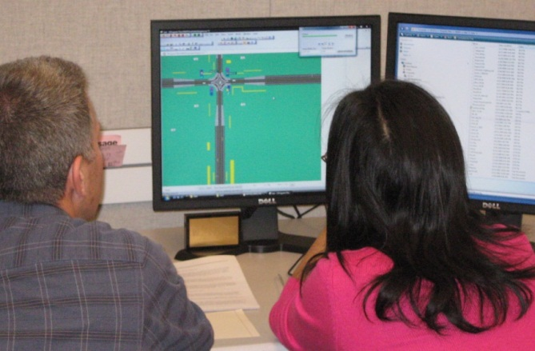
Research Simulator
Focus Area: PC Simulation
Installed at the Human Factors and Statistical Modeling Lab at the University of Washington
http://depts.washington.edu/hfsm/index.html
Equipped with:
  Toyota Avalon Steering Wheel
  Functional Adaptive Cruise Control System
Research Areas Include:
  Human Factors in Transportation
  Behavioral Risks and Uncertainty
  Human Performance and Working Memory

Slide 9
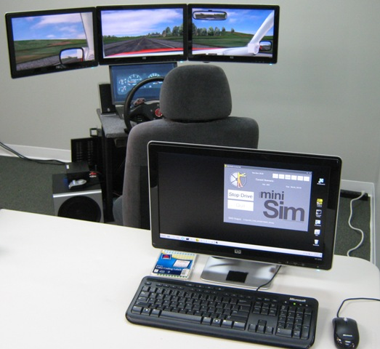


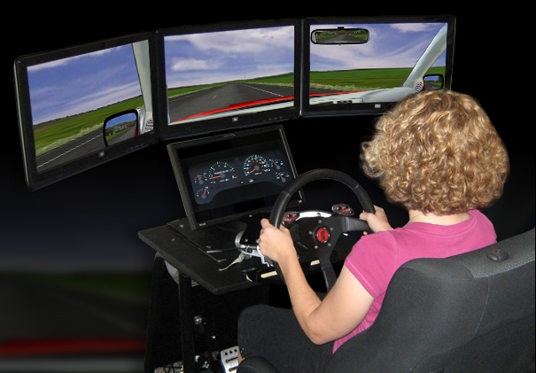
MiniSims for Multi-Site Clinical Trial Data Collection
Focus Area: NADS MiniSim
Validated MiniSim against simulator currently in use; an in-house study with oral alcohol dosing and placebo
Development of over 6 hours of scenarios with divided attention task
Screening, Training, and Practice drives
Integration with customer’s launch application
Hardware and software configuration control
Development of playback function to show equivalency of data across multiple simulators
Five study locations
Installation at two sites

Slide 10
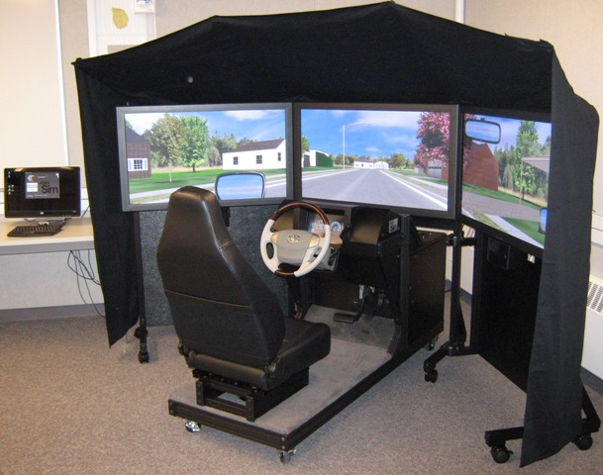
Iowa State University MiniSim
Project Goals
  Support outreach for visualization projects (Iowa DOT)
  Trailer mounted MiniSim
  240 Hz LCD Display to support 3D research
  ISAT tool for scenario authoring
  Visual appeal

Slide 11



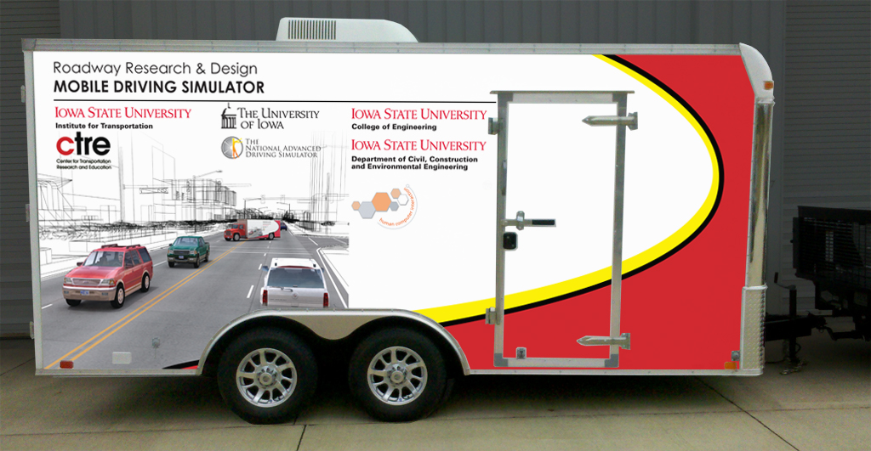
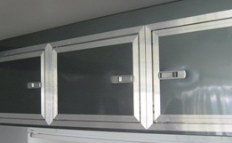
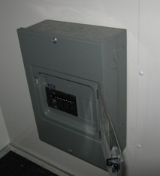
Iowa State University Trailer
United UXT, 16’ ft x 8.5 ft
White, smooth sides
Storage cabinets, 120V lighting, A/C
Custom graphic design

Slide 12
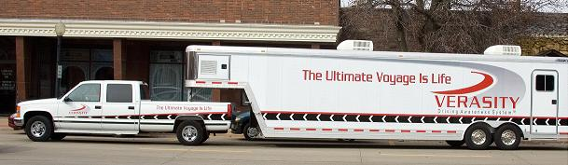
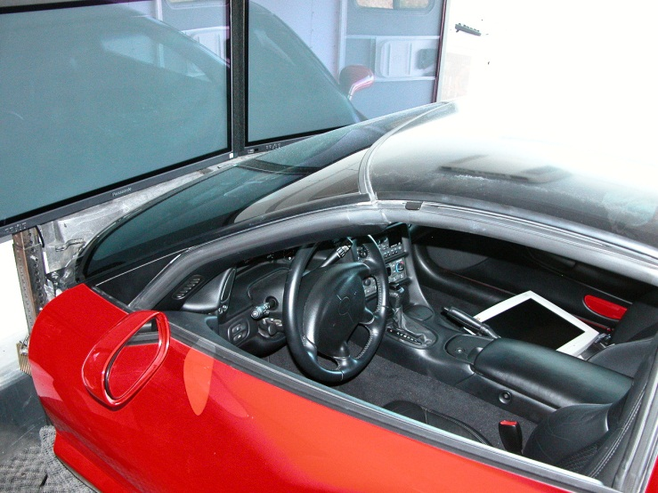
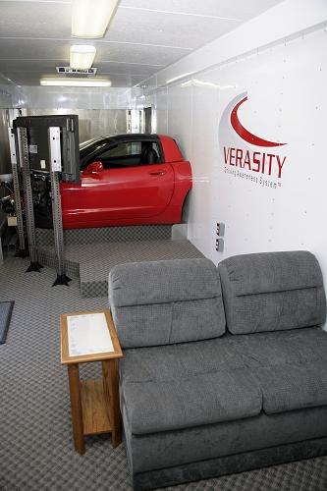
Veracity Mobile Simulator
Development of mobile driving simulator
  Education about drug and alcohol impairment
  Driver Evaluation
  Driver Training
Corvette Cab
MiniSim Software
Completed in 2005

Slide 13
Heavy-Truck MiniSim™ Mobile Trainer
Sponsor: United Tribes Community College
Project Duration: 8 months (Jan ’09 – Aug ‘09)
Summary:
  Sponsor needed a mobile PC-based simulator for exposing drivers to heavy truck safety/training issues
  Project included:
    development of heavy truck training scenarios
    drive assessment package
    integration of the heavy truck dynamics and transmission models
    procurement of hardware parts to construct a mobile based MiniSim
    installation, delivery and training
    support for one year

Slide 14
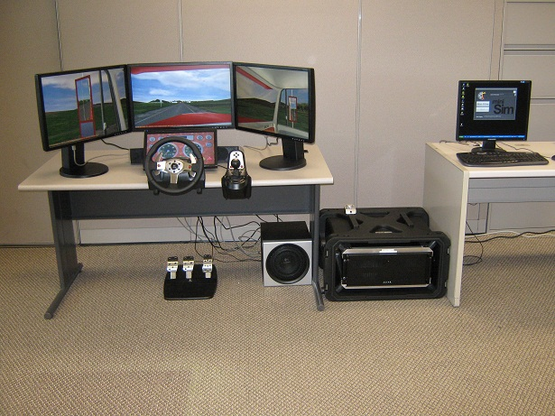

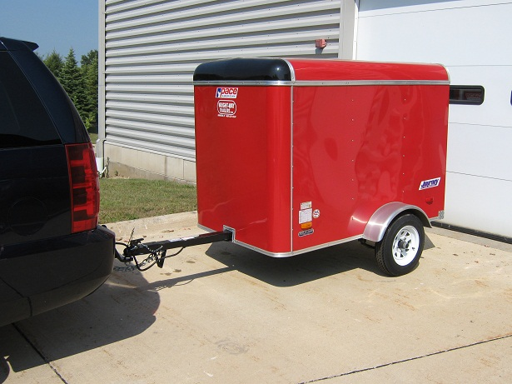
Heavy Truck MiniSim™ Mobile Trainer

Slide 15

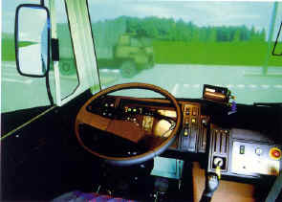
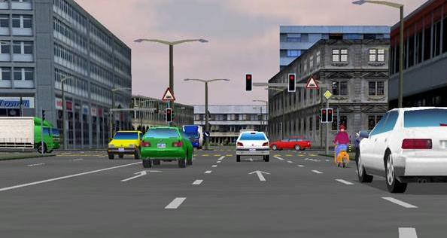
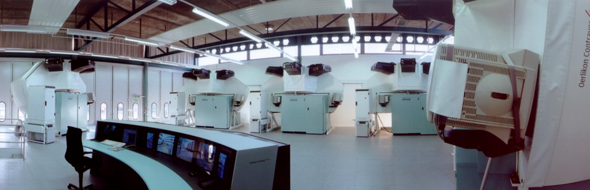
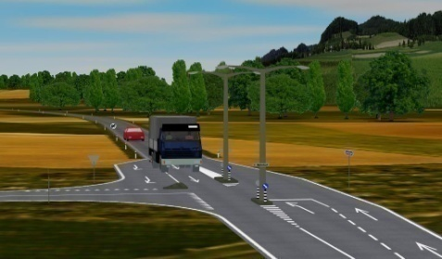
Truck Training Simulator
Focus Areas: Heavy Truck, Driver Training
Swiss-specific driving environment and traffic
Subcontractor to a defense company
Supplied real-time software modules and off-line tools
Integrated at customer’s site
40 units installed at 5 locations in Switzerland

Slide 16
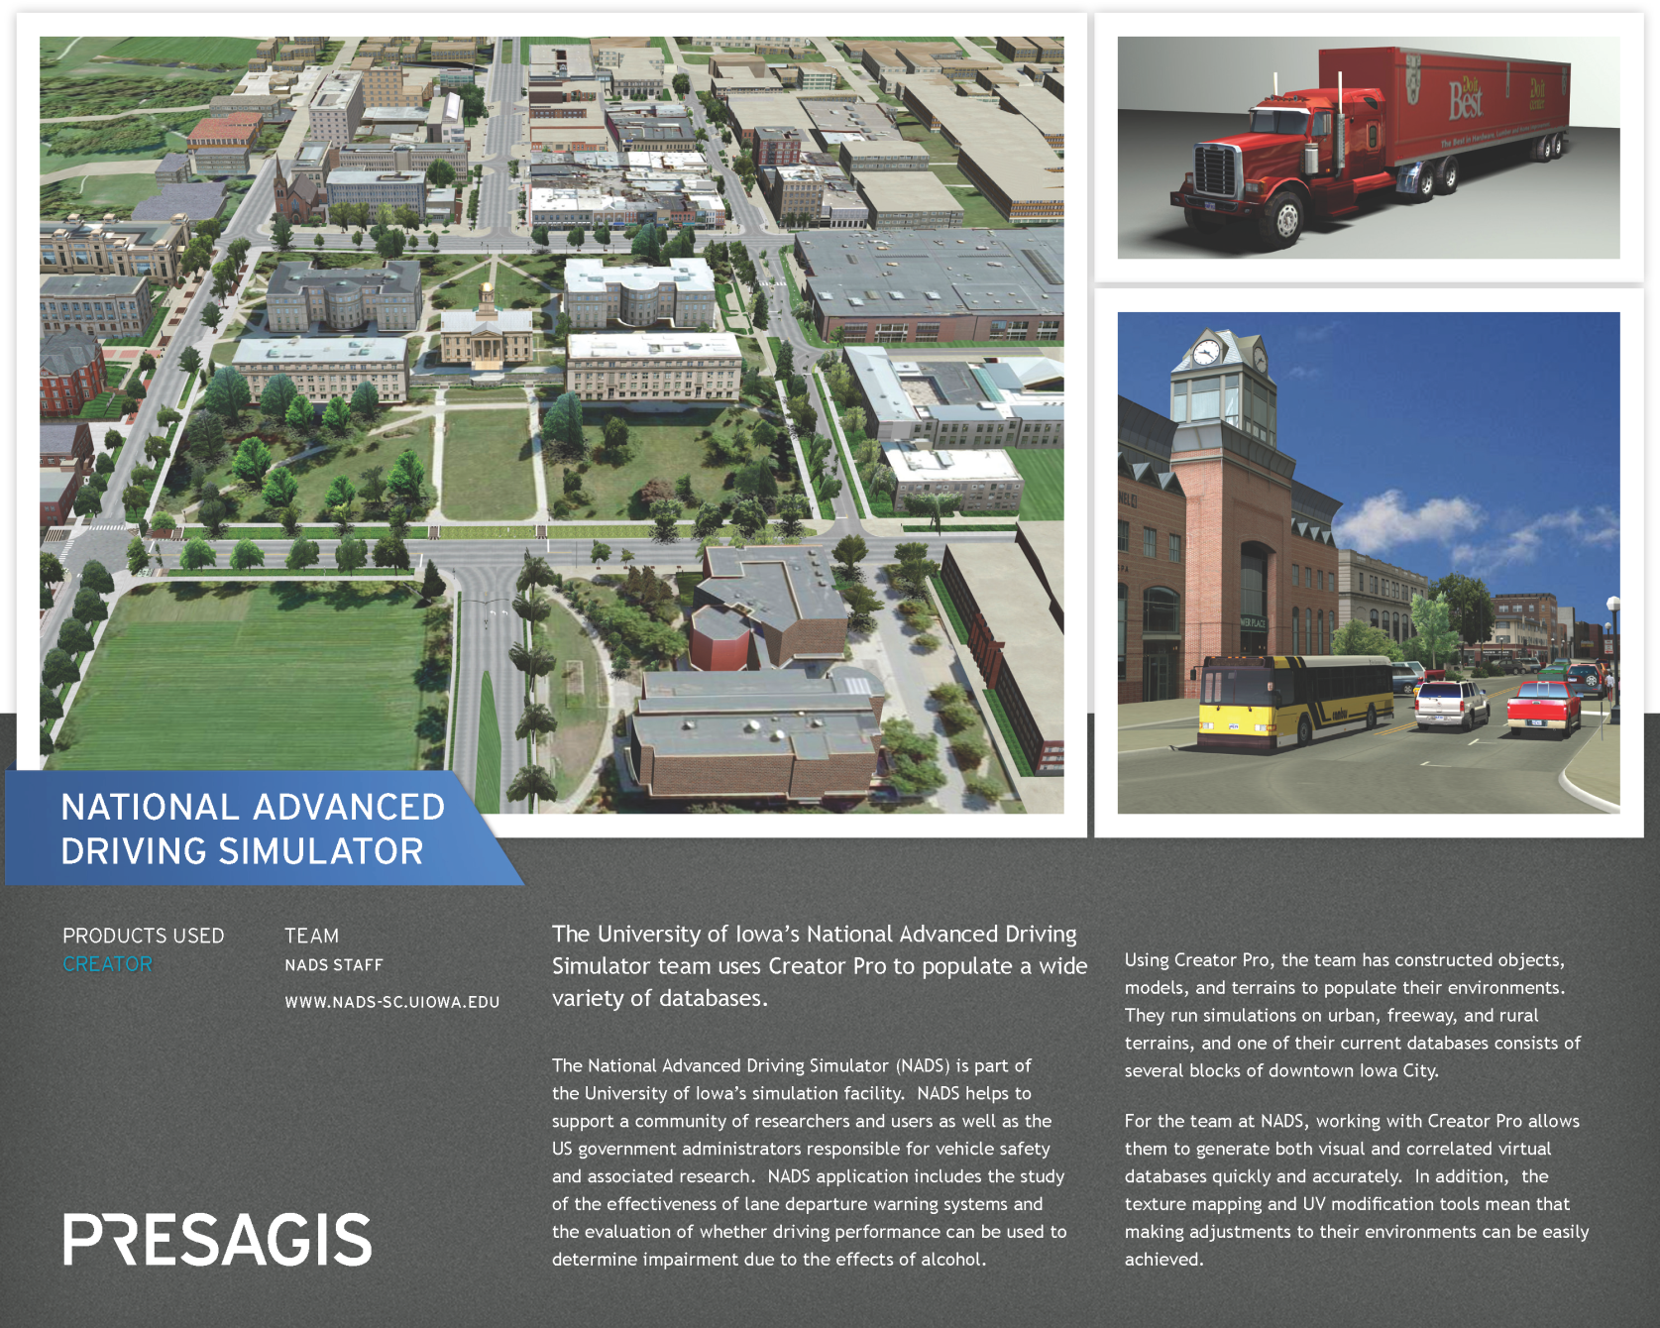
Focus Areas: Visualization and Geo-Specific Driving Environments
Virtual Iowa City

Slide 17
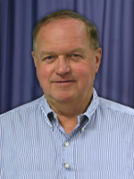
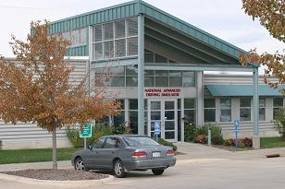

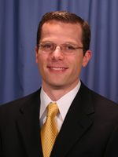
Contact Information
Herm Reininga
Director
National Advanced Driving Simulator
E-mail: herman-reininga@uiowa.edu
Ph: 319-335-4850
Omar Ahmad
Assistant Director
National Advanced Driving Simulator
E-mail: omar-ahmad@uiowa.edu
Ph: 319-335-4788
Mail Address:
National Advanced Driving Simulator
The University of Iowa
2401 Oakdale Blvd.
Iowa City, IA 52242
U.S.A.
E-mail: contacts@nads-sc.uiowa.edu
Andrew Veit
MiniSim Program Manager
National Advanced Driving Simulator
E-mail: andrew-veit@uiowa.edu
Ph: 319-335-4361

