Slide 1
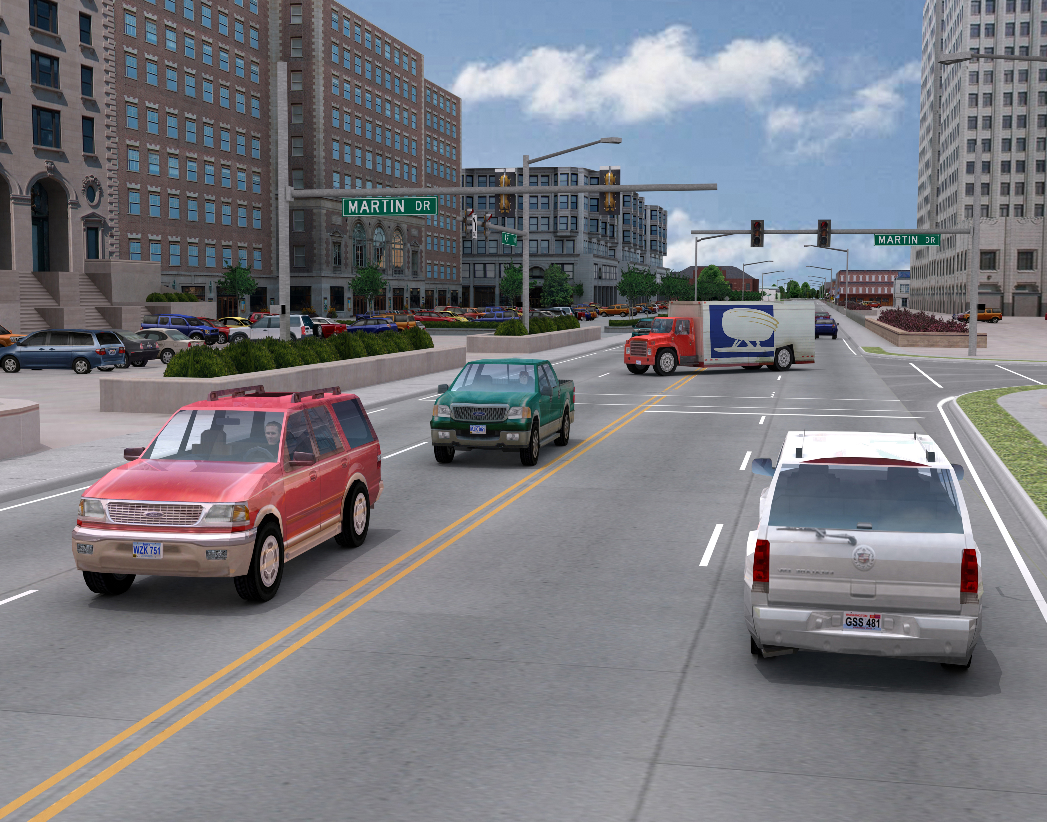
ISAT Quick Start
Interactive Scenario Authoring Toolkit
ISAT Purpose:
Design, rehearse scenarios for simulation
and review drive data contained in the DAQ
How:
Assemble scenario elements to create an
experience for the simulator driver, aka
External Driver (XD)
Triggers
Dynamic elements, i.e. traffic,
Static elements, i.e. signs, ob
NOTE: ISAT is not a 3D modelling tool

Slide 2
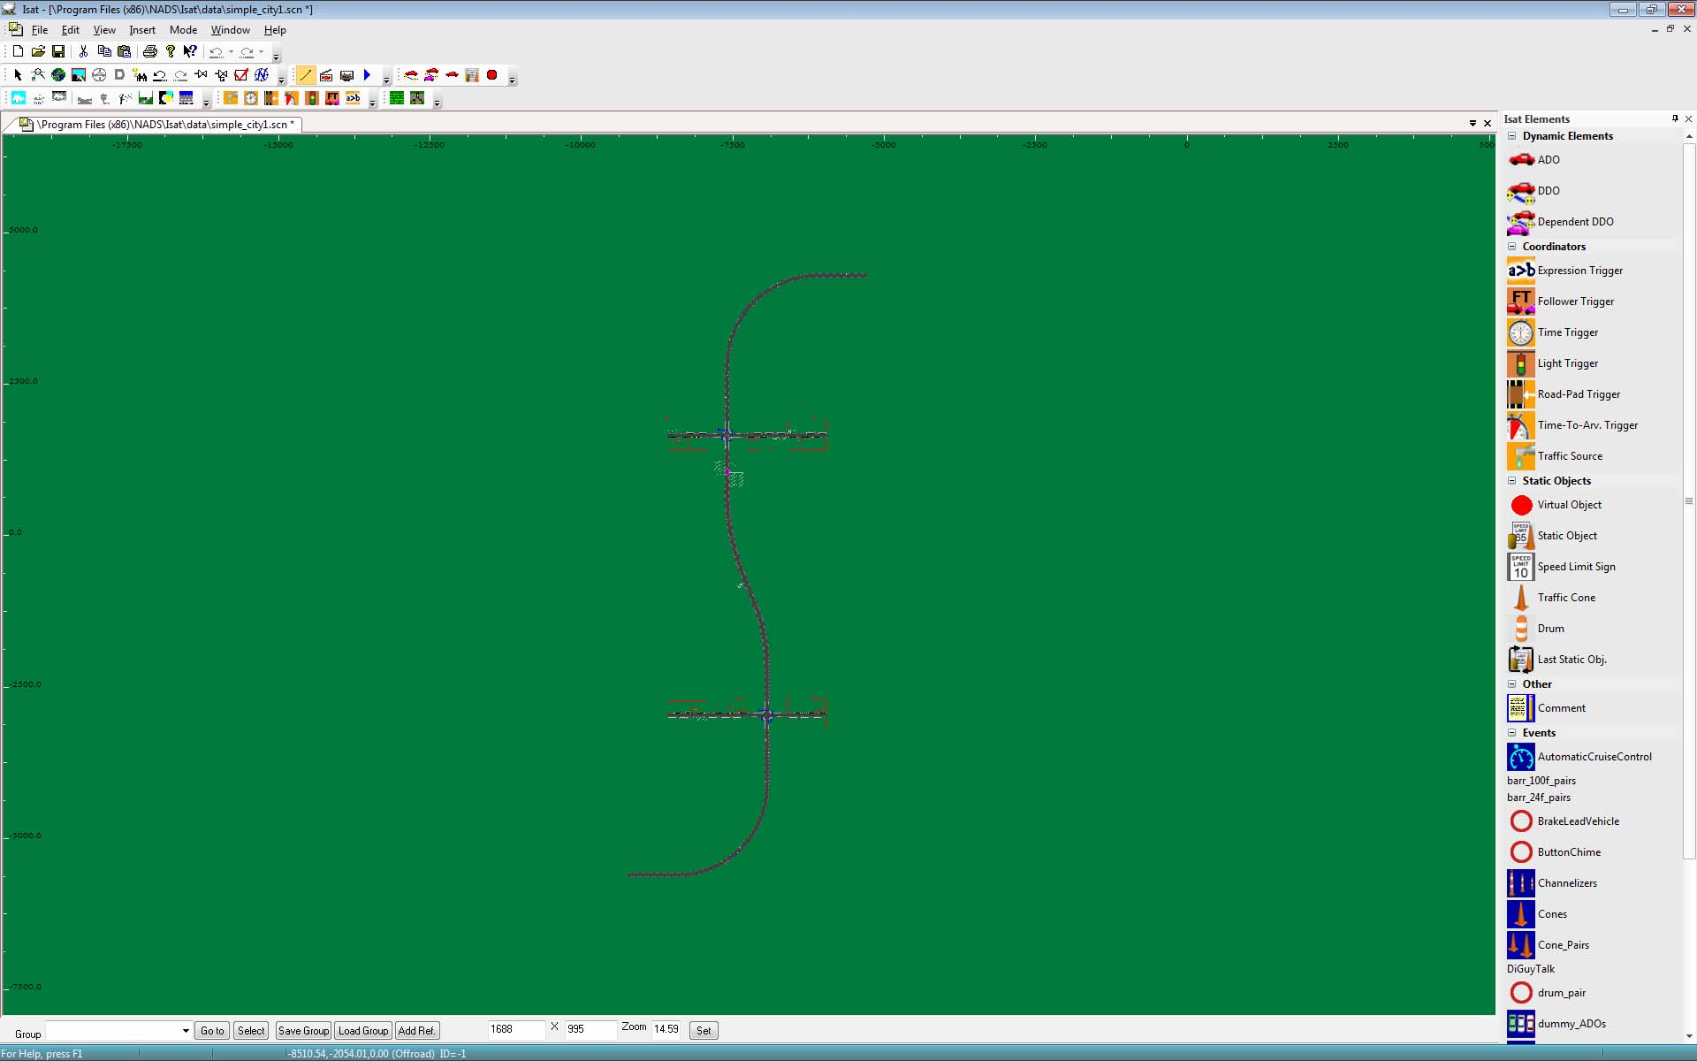
ISAT Quick Start
Interactive Scenario Authoring Toolkit
Requirement:
ISAT requires a roadmap (BLI) to use
for every scenario.
Can I re-use a scenario from one BLI
on a different BLI?
Not entirely. Many scenario elements
contain data specific to the BLI, so it is not possible to just use the scenario on another BLI.
However you can copy most elements from
one BLI to another.
ISAT workspace
Roadmap/BLI

Slide 3
ISAT Quick Start
Scenario Authoring Tools
Everything in a simulation happens as a
result of the scenario.
How do things happen in a simulation?
Triggers/coordinators issue commands to the simulator via ACTIONS to operate on other scenario elements (traffic, triggers, static objects), the environment or to perform calculations.
Dynamic elements in a scenario can
activate triggers as well as the XD.
Triggers:
Roadpad
Time
Expression
Time to arrival
Follow
Traffic Signal
Geometric Position

Slide 4
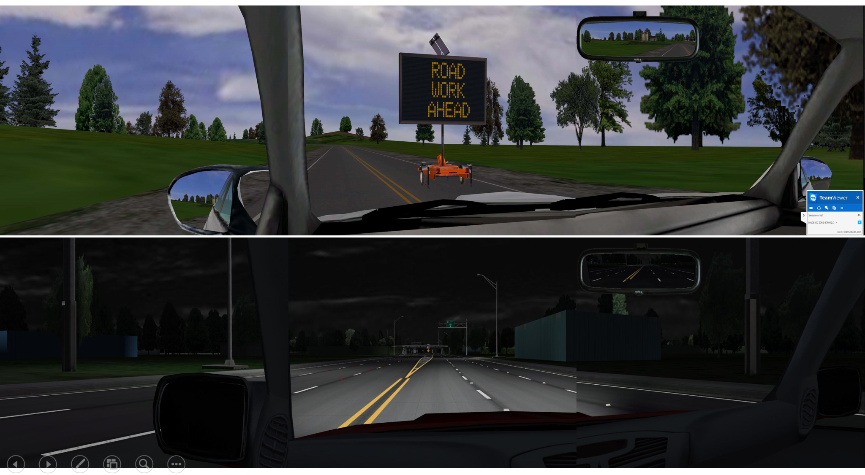
ISAT Quick Start
Triggers & Predicates (activators)
Each trigger has a unique activation but they all share the same actions:
Roadpad – something ‘steps on’ the trigger road pad
Time – elapsed or delay time threshold reached
Expression – when the expression evaluates to True, the actions are executed
Time to Arrival – adds a time element to a roadpad trigger; when the time is reached, the actions execute
Follow – any two dynamic elements occupying the follow trigger roadpad; when conditions are satisfied the actions execute
Traffic Signal – when the specified signal state is achieved the actions execute
Geometric Position – not currently working; can emulate with a time trigger that has a creation radius (area where the trigger is alive)

Slide 5
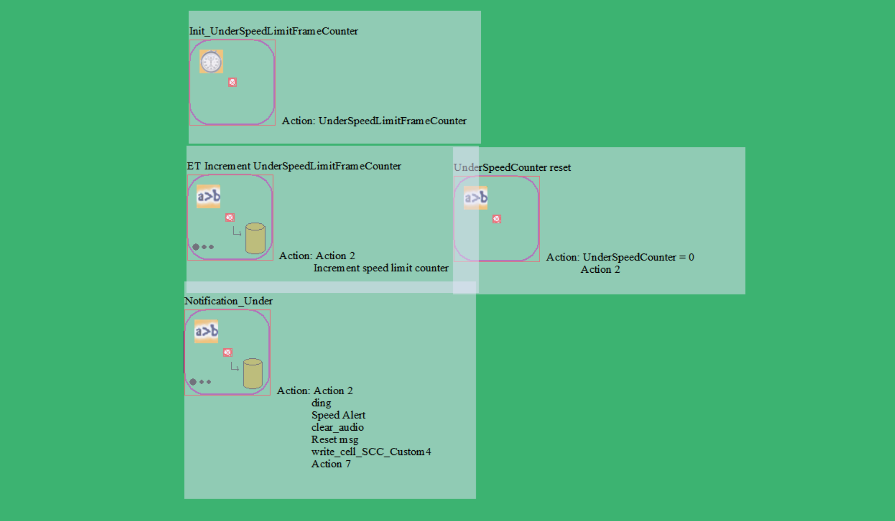
ISAT Quick Start
Which Trigger is Right?
Because triggers share the same actions, there is not any one “right” trigger, but some triggers are most appropriate for specific situations:
Roadpad – use to define a particular location on the roadmap. Can also be filtered to a specific lane at that location.
Time – operates independent of location unless a creation radius is defined – then it works like a Geometric Position trigger.
Expression – when the actions should execute depending on some other thing or things.
Time to Arrival – when a time element is desired at a specific location on the roadmap; often used to accommodate different driver performance styles (aggressive vs. conservative).
Follow – when a spatial relationship between 2 elements is needed (i.e. for completing a passing maneuver).
Note:
Sometimes multiple triggers are needed to work together to accomplish a task, such as a driver performance monitoring and alert system

Slide 6
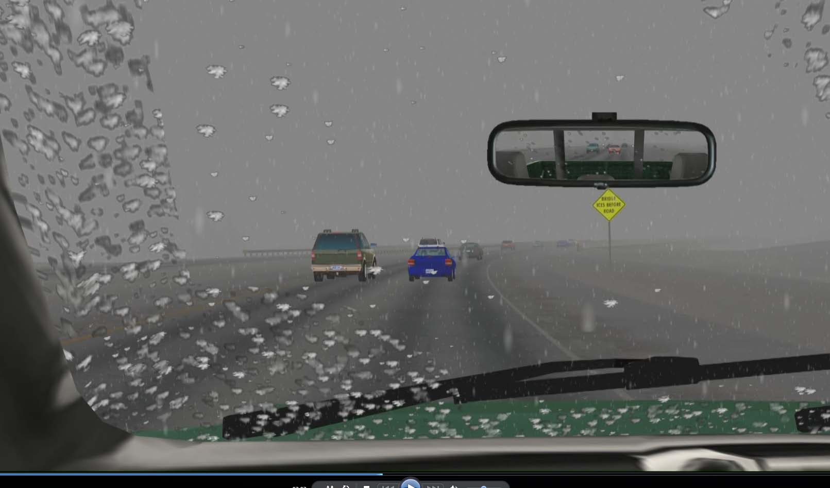
ISAT Quick Start
Triggers: Actions
Actions are the commands executed during a simulation:
Create or remove scenario elements
Control elements (speed up, slow down, adjust lane position) or environmental conditions
Change traffic signal states (i.e. change red light to green)
Play an audio message (sound)
Show information on-screen for the XD as text
Retrieve information about a scenario element and use it or save it into a variable
Perform some calculation on the retrieved information
Actions are typically organized around Events (something of interest or significance during a simulation).

Slide 7
ISAT Quick Start
Library of Object Models
ISAT and miniSim use a shared library of object models to populate the simulation called the Scenario Object Library. The library is defined within one sol2.txt and additional resource files beginning with sol2_aux.
ISAT uses ‘proxy models’ of the actual models used in miniSim. These are 2d or image representations.
Placing objects in a scenario within ISAT results in those models being created in the miniSim simulation.

Slide 8
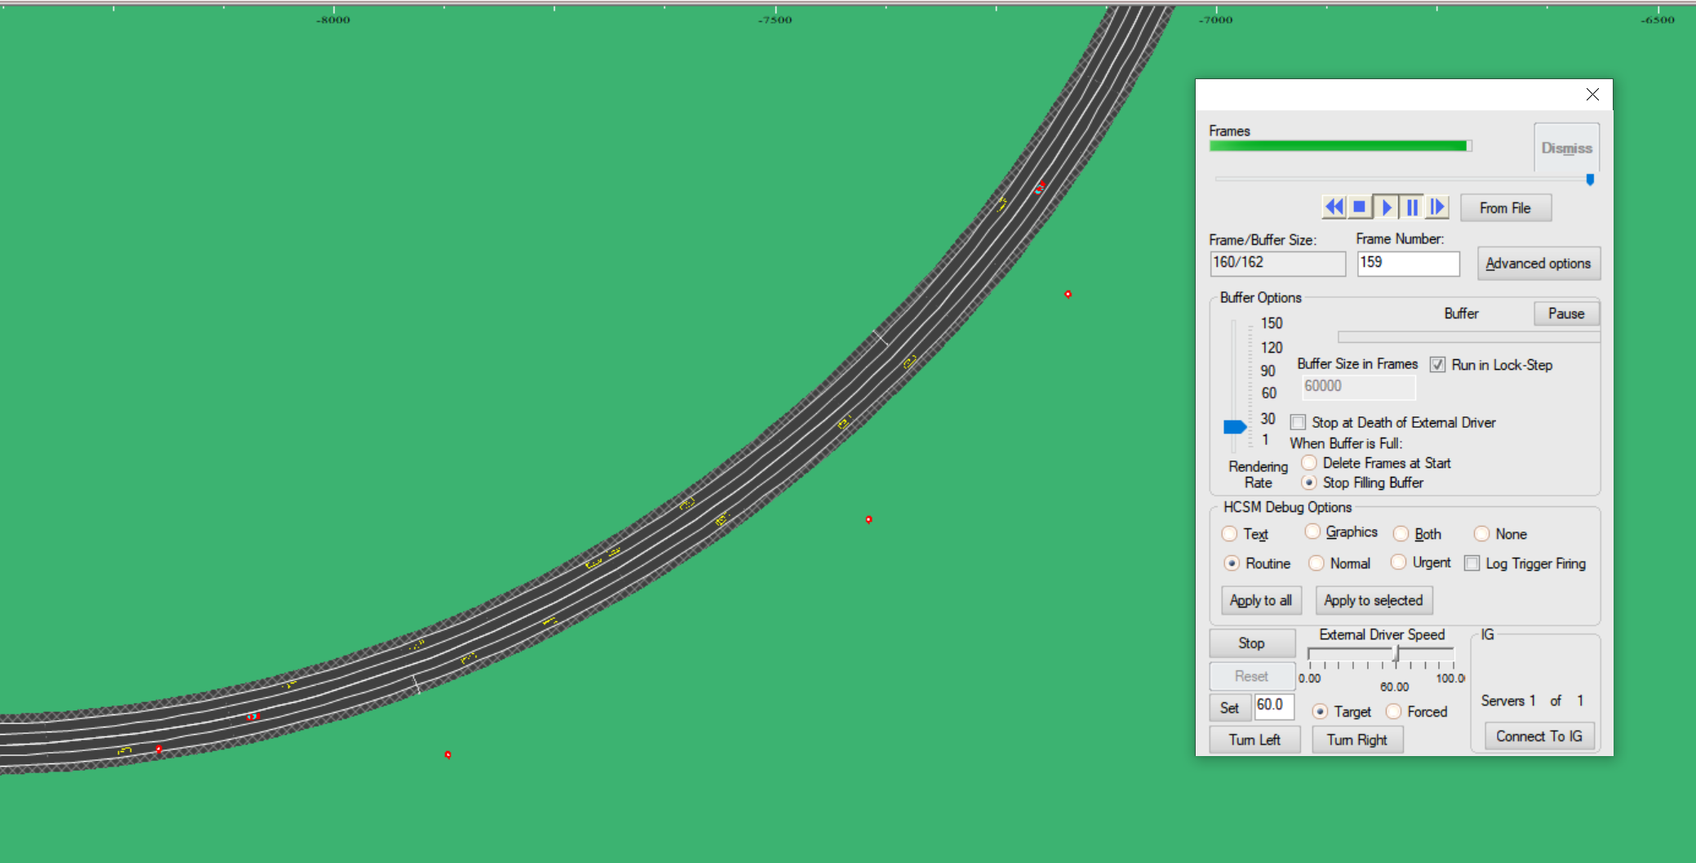
ISAT Quick Start
Rehearsal Mode
Rehearsal mode provides a way to exercise a scenario before driving it on the miniSim. It is often used as a way to test general timing or confirm triggers are executing as planned.
Rehearsal is NOT a substitute
for test driving a scenario on miniSim.
Scenario authoring is a highly iterative process and the best way to approach it is to test every step of development where appropriate.
It’s probably not practical (or efficient) to drive a scenario after every change – but rehearsal is a quick and efficient way to check your work!
Trigger Locations along XD route of travel
XD

Slide 9
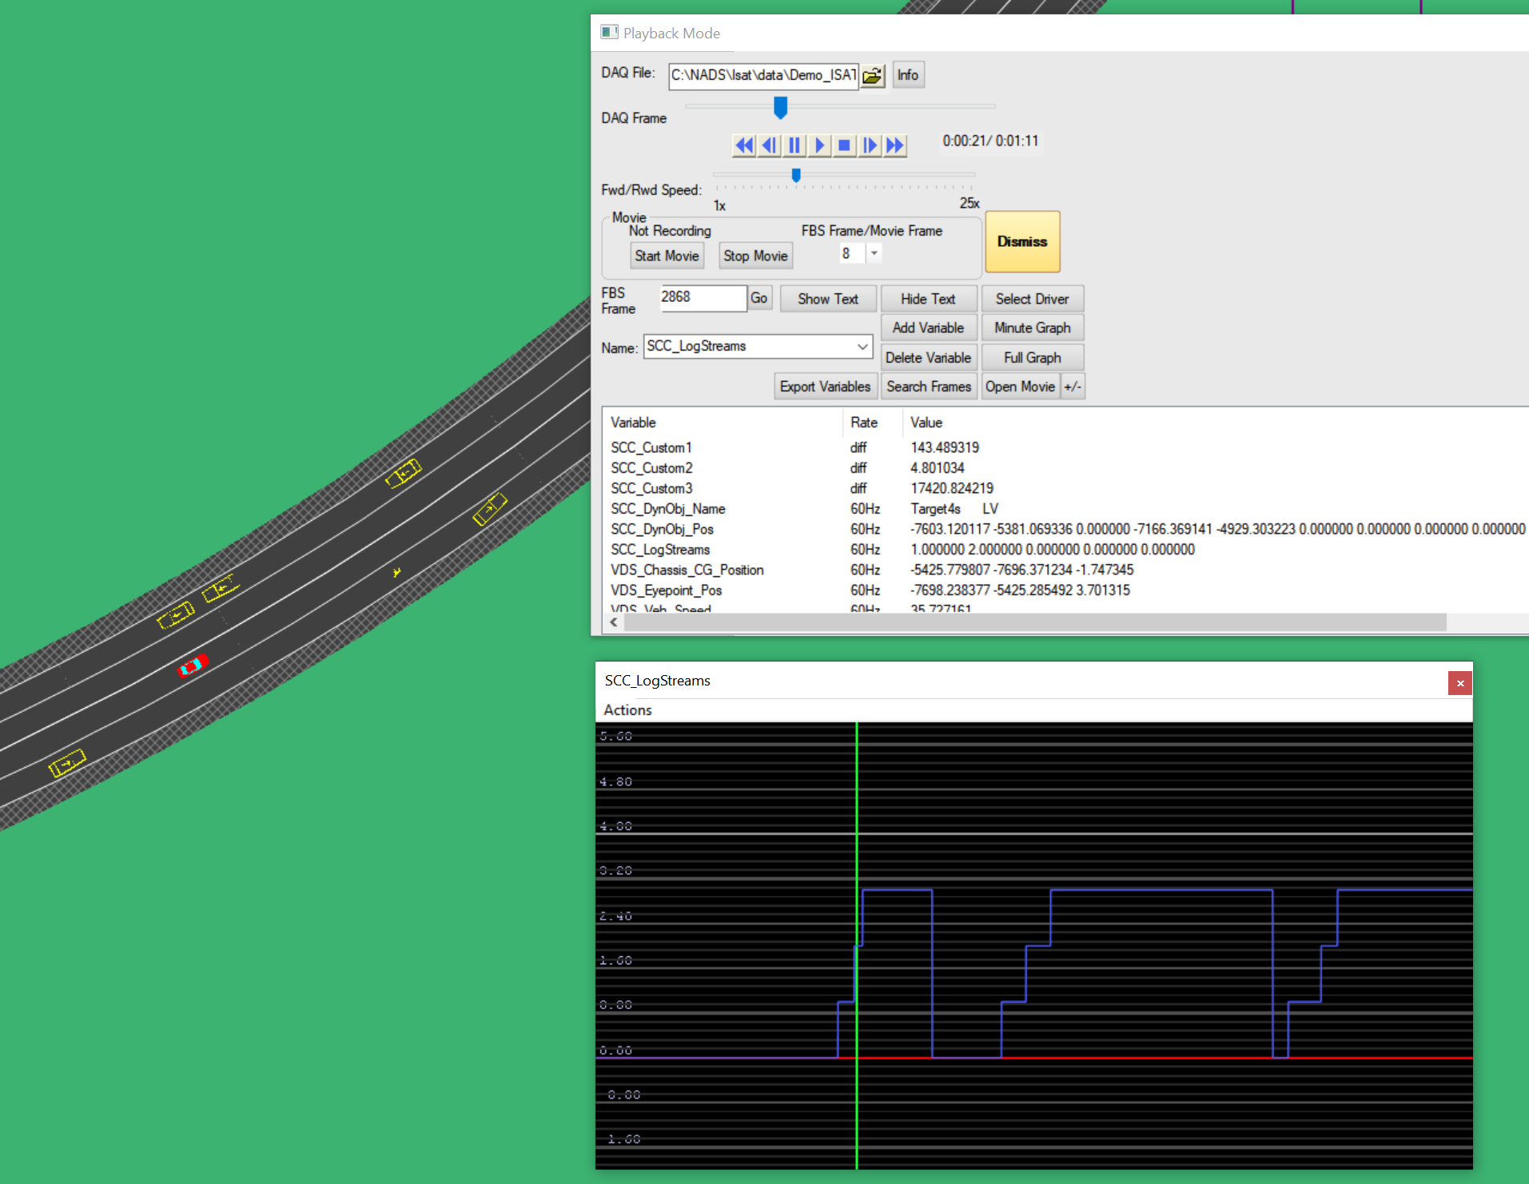
ISAT Quick Start
DAQ Review Mode
DAQ review of a miniSim drive can be used during development to ensure scenario elements are working as intended. Problems can be isolated, identified, corrected and verified before releasing the scenario for use in data collection with human participants.
Variable from drive
Variable plot from drive

Slide 10
ISAT Quick Start
Additional Resources
Additional ISAT and scenario resources are available at:
The ISAT User Guide on the miniSim support site
at:
https://www.nads-sc.uiowa.edu/minisim/wiki/index.php?title=ISAT_User_Guide_Table_of_Contents

